Slide 1






Decoding Consumer Spending: Strategic Retail Insights That Drive Growth
by Olumide Balogun

Slide 2

Executive Summary
Objectives of the Project
Business Questions
Tools Used throughout the Project
Methodology
Key Findings: Insights, EDA Visualizations, and Model-Driven Interpretations
Strategic Recommendations
Expected Business Impact
Conclusion
Table of Contents
Olumide Balogun +234-8065060691
2

Slide 3

This end-to-end, Python-powered analytics pipeline was developed to extract, analyze, and transform U.S. retail sales data into strategic, real-time business intelligence. By decoding the complexities of customer behavior, product performance, and regional sales trends, the project empowers data-driven decision-making at scale.
Key methodologies included: Exploratory Data Analysis (EDA) for trend discovery, Prophet forecasting to anticipate sales movements, Market Basket Analysis for cross-selling opportunities, and KMeans clustering to segment customers and uncover behavioral patterns
Rather than stopping at “what happened,” the analysis dove into the why, and most importantly, the what’s next.
Impact: Streamlined marketing strategies tailored to customer segments, Data-informed inventory decisions to reduce overstock and stockouts, and Forecasts that prioritized profitability, not just revenue
As a result, Chris & Kris gained a competitive, predictive edge, fuelled by insight, not guesswork.
Key Insights
Sales & Performance
Revenue peaked in December ($6.41M); February saw a sharp 73.39% dip, confirming strong seasonal swings. November sales surged +226.47% due to holiday campaigns, timing is everything.
Executive Summary
Olumide Balogun +234-8065060691
3

Slide 4
Executive Summary (continued)
Product & Consumer Behavior
The Top sellers are AAA Batteries, Charging Cables, Galaxy Buds, and accessories are the unsung heroes. Tuesdays, especially 11 AM–2 PM and 6–9 PM, are the sweet spots for customer traffic.
Bundle purchases (e.g., phone + cable) reveal solid cross-sell potential.
3. Market Insights
San Francisco, LA, NYC lead in revenue; Portland (ME) and Austin show untapped potential.
Clustering analysis uncovered 3 market tiers for tailored regional approaches.
4. Forecasting & Strategy
Prophet model shows Q4 growth and early 2025 volatility; consistent >$1M monthly sales supports solid budgeting.
Timing campaigns with peak shopping hours can boost ROI significantly.
Strategic Recommendations
Maximize Q4: Double down on marketing, inventory, and staffing.
Promote Bundles: Elevate AOV with high-frequency product pairings.
Target Peak Hours: Optimize promotions for Tuesdays and key shopping windows.
Invest in Top Cities: Scale up efforts in SF, LA, NYC.
Revive Low-Performers: Localized campaigns for Portland and Austin.
Forecast-Driven Planning: Leverage Prophet to guide resource allocation.
Olumide Balogun +234-8065060691
4

Slide 5

Objectives of this Project
The primary objective of this project was to transform raw transactional sales data into actionable business insights that support data-driven decision-making and strategic growth for Chris & Kris, a U.S.-based retail company. Specifically, the project aimed to:
Uncover hidden sales patterns and highlight untapped growth opportunities.
Identify top-performing products and cities contributing the most revenue.
Understand customer purchasing behavior to better time and target marketing efforts.
Forecast future sales trends for smarter budgeting, inventory planning, and resource allocation.
Recommend tailored strategies using advanced analytics like customer segmentation, market basket analysis, and sales forecasting.
Olumide Balogun +234-8065060691
5

Slide 6

1. Which month achieved the highest total sales, and what was the total sales figure recorded during that period?
2. What is the percentage growth in total monthly sales over time, and how does it vary across different months?
3. Which city achieved the highest total sales, and what was the total sales amount for that city?
4. Which product had the highest sales, and what factors do you believe contributed to its success?
5. How do product sales vary across different days of the week, and what insights can be drawn from the distribution of order volumes by product and day?
6. On which day of the week do customers make the most purchases?
7. What is the optimal timing for advertisements and promotions to maximize customer purchases, based on historical purchase behavior?
8. What will our monthly sales look like over the next two years based on historical purchasing patterns?
9. What products are frequently bought together?
10. How can we group cities based on sales performance to uncover patterns for better sales strategy?
Business Questions
Olumide Balogun +234-8065060691
6

Slide 7

1. Python: The foundation of my analysis, enabling efficient data manipulation and insight extraction. Key libraries included:
Pandas for data cleaning and analysis
Matplotlib for basic data visualizations
Seaborn for enhanced and detailed plotting
2. Machine Learning: To uncover patterns and make predictive insights, I incorporated:
scikit-learn for model development and evaluation
XGBoost for high-performance gradient boosting
Prophet for time series forecasting
3. Jupyter Notebooks: Provided an interactive coding environment, allowing for seamless integration of code, analysis, and documentation.
4. Git & GitHub: Used for version control, code management, and collaboration, ensuring transparency and reproducibility throughout the project.
Tools Used throughout the Project
Olumide Balogun +234-8065060691
7

Slide 8

Phase I: EDA – Descriptive & Diagnostic Analysis
Phase II: Machine Learning – Predictive & Prescriptive Models
Methodology
1. Data Cleaning & Preprocessing: Removing duplicates, handling missing values, creating more columns, and formatting variables
2. Monthly Sales Analysis: Identified the highest-grossing months and overall trends.
3. City-Level Analysis: Mapped sales performance geographically.
4. Product & Weekly Trends: Uncovered product demand patterns by weekday.
5. Insights Visualization: Created clear visuals (bar charts, heatmaps) for storytelling.
1. Time Series Analysis: Determined optimal times for promotions and customer engagement.
2. Sales Forecasting: Used Prophet models to predict future sales.
3. Market Basket Analysis: Revealed frequent product pairings using Apriori algorithm or any other analysis.
4. Clustering: Applied KMeans to segment cities for targeted sales strategies.
Olumide Balogun +234-8065060691
8

Slide 9

Key Findings: Insights, EDA Visualizations, and Model-Driven Interpretations
Olumide Balogun +234-8065060691
9

Slide 10
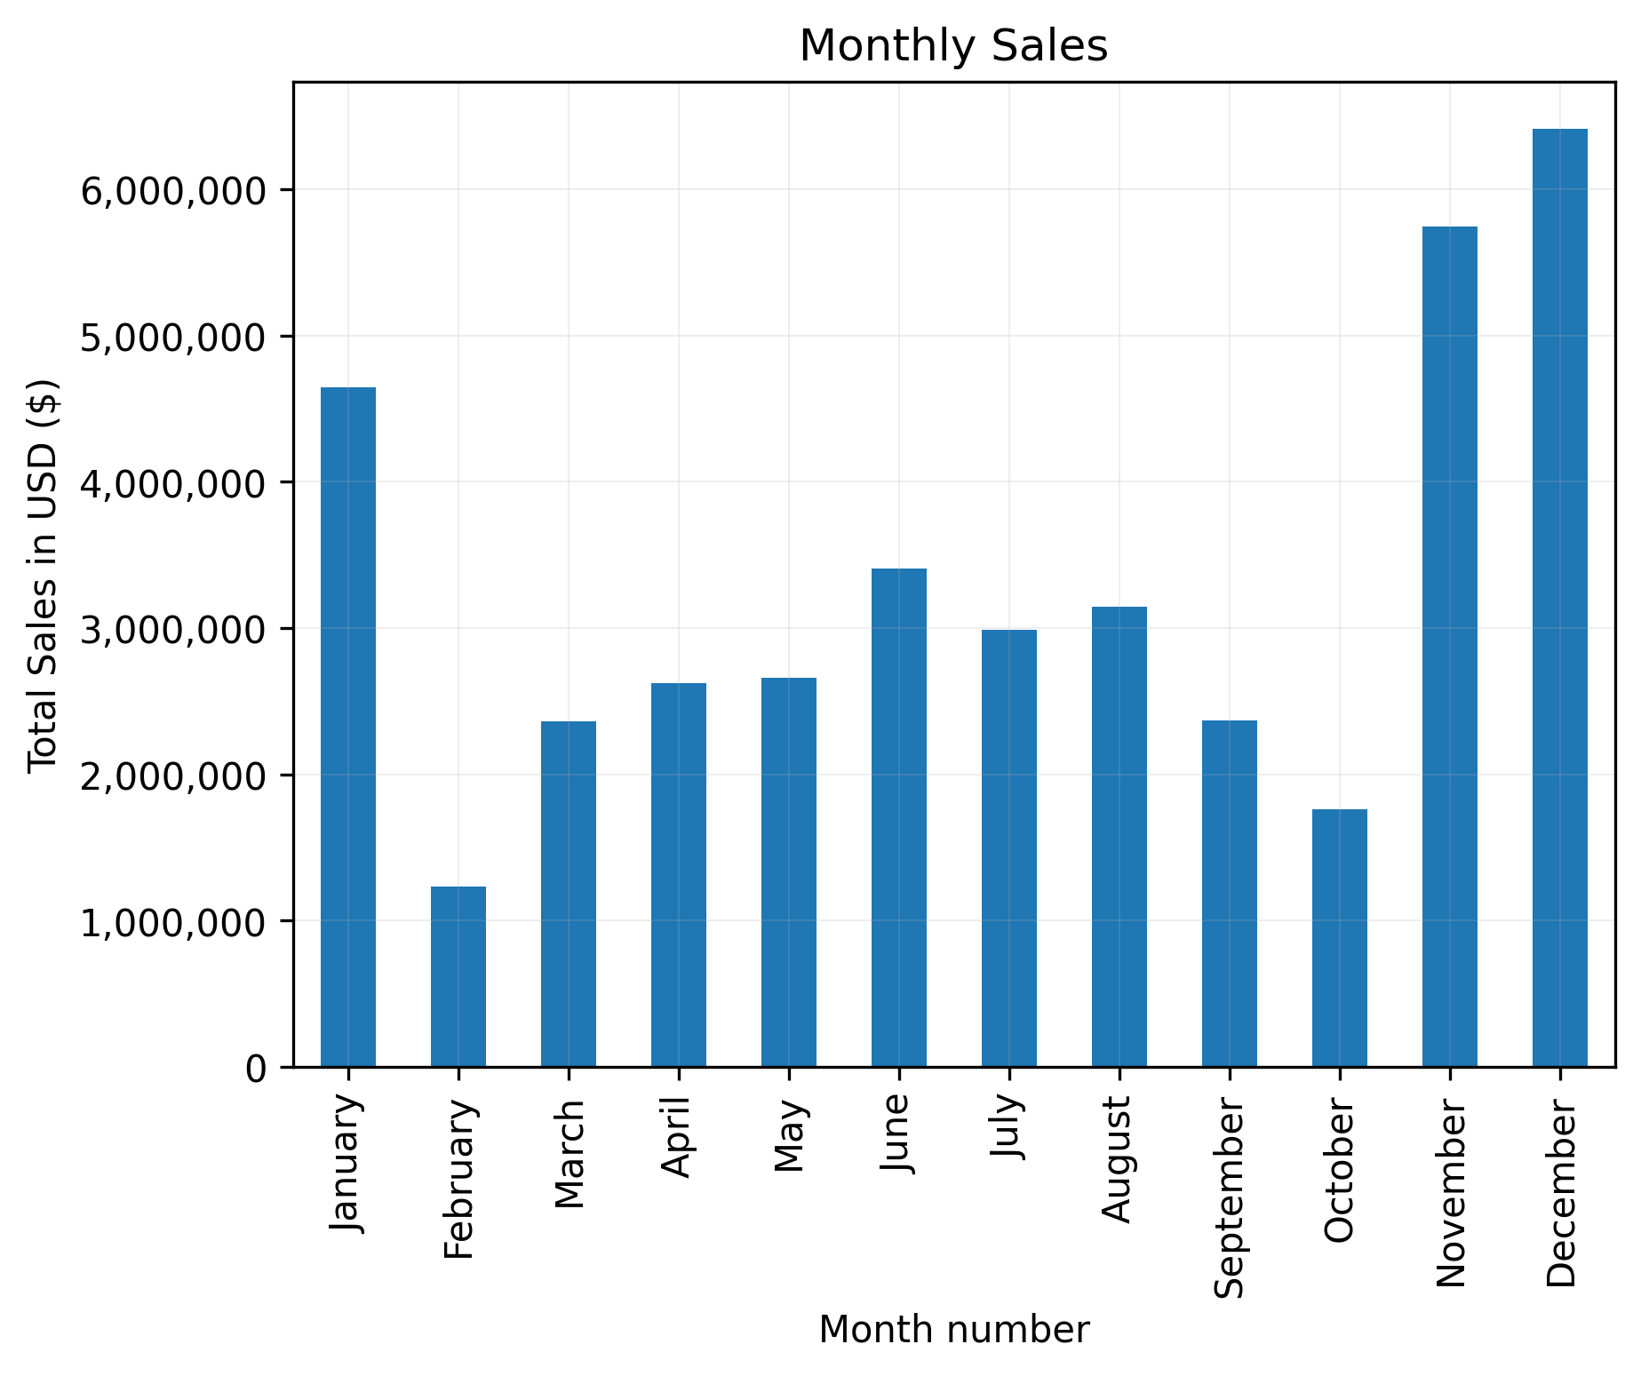

Which month achieved the highest total sales, and what was the total sales figure recorded during that period?
Monthly Sales Performance Trends
Key Insights
December reigns supreme with $6.41M in revenue, proving the unmatched power of Q4 and holiday-driven consumer spending.
February is a red flag, recording the lowest sales at $1.24M, a signal to rethink early-year strategies.
Sales momentum builds from June onward, showing a consistent lead-up to year-end peaks.
Olumide Balogun +234-8065060691
10

Slide 11
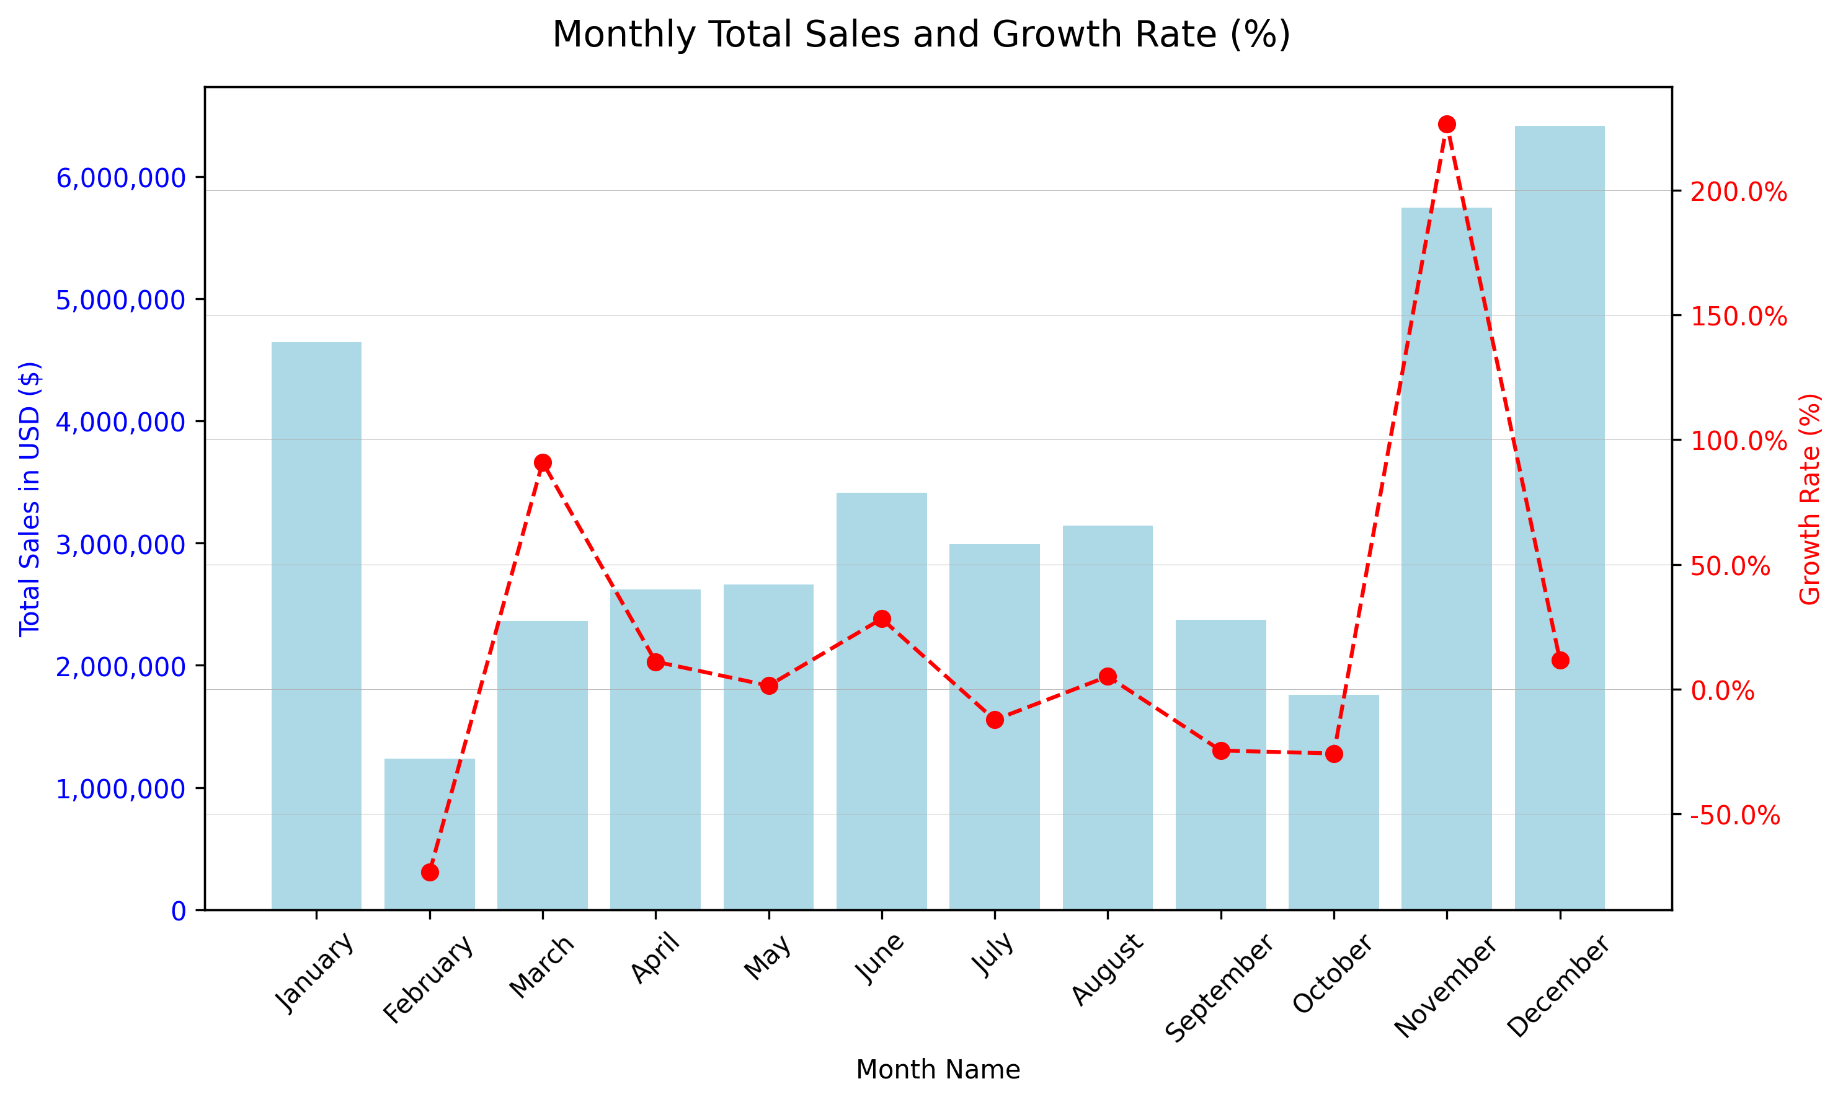
What is the percentage growth in total monthly sales over time, and how does it vary across different months?
Monthly Sales Growth Analysis: Unveiling the Momentum
Key Insights
November shows explosive growth at +226.47%, driven by pre-holiday promotions, double down on this period.
February (-73.39%) and October (-25.77%) reveal volatility, highlighting the need for buffer campaigns and agile planning.
Growth is uneven, a reminder that demand planning must adapt to both calendar seasons and consumer mood shifts.
Olumide Balogun +234-8065060691
11

Slide 12
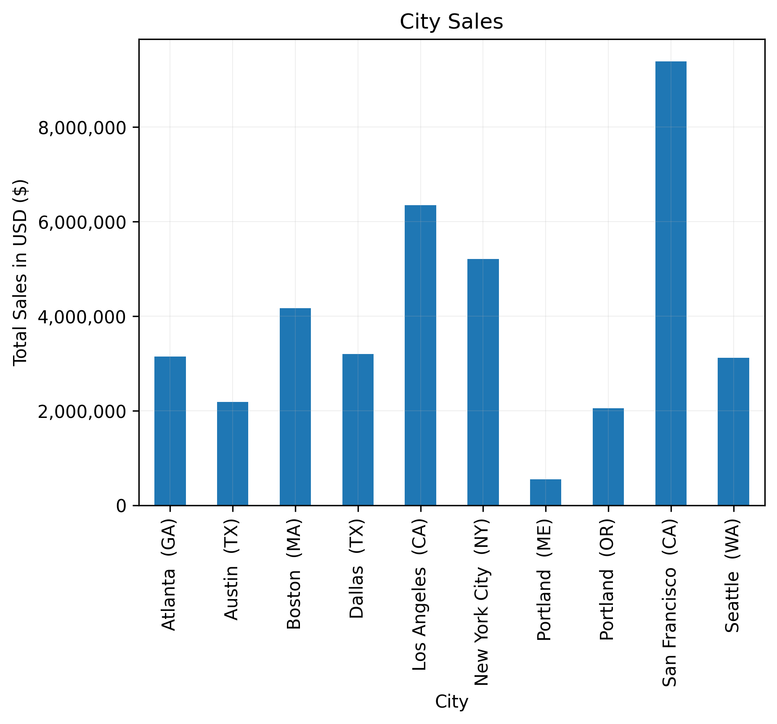
Which city achieved the highest total sales, and what was the total sales amount for that city?
Geographic Sales Performance Analysis
Key Insights
San Francisco dominates the leaderboard with $9.4M in total sales, over 17x more than Portland (ME).
LA and NYC are revenue magnets with $6.35M and $5.21M respectively, solidifying the value of investing in metro hubs.
Mid-tier cities like Austin and Portland (OR) represent untapped potential with the right local strategies.
Olumide Balogun +234-8065060691
12

Slide 13
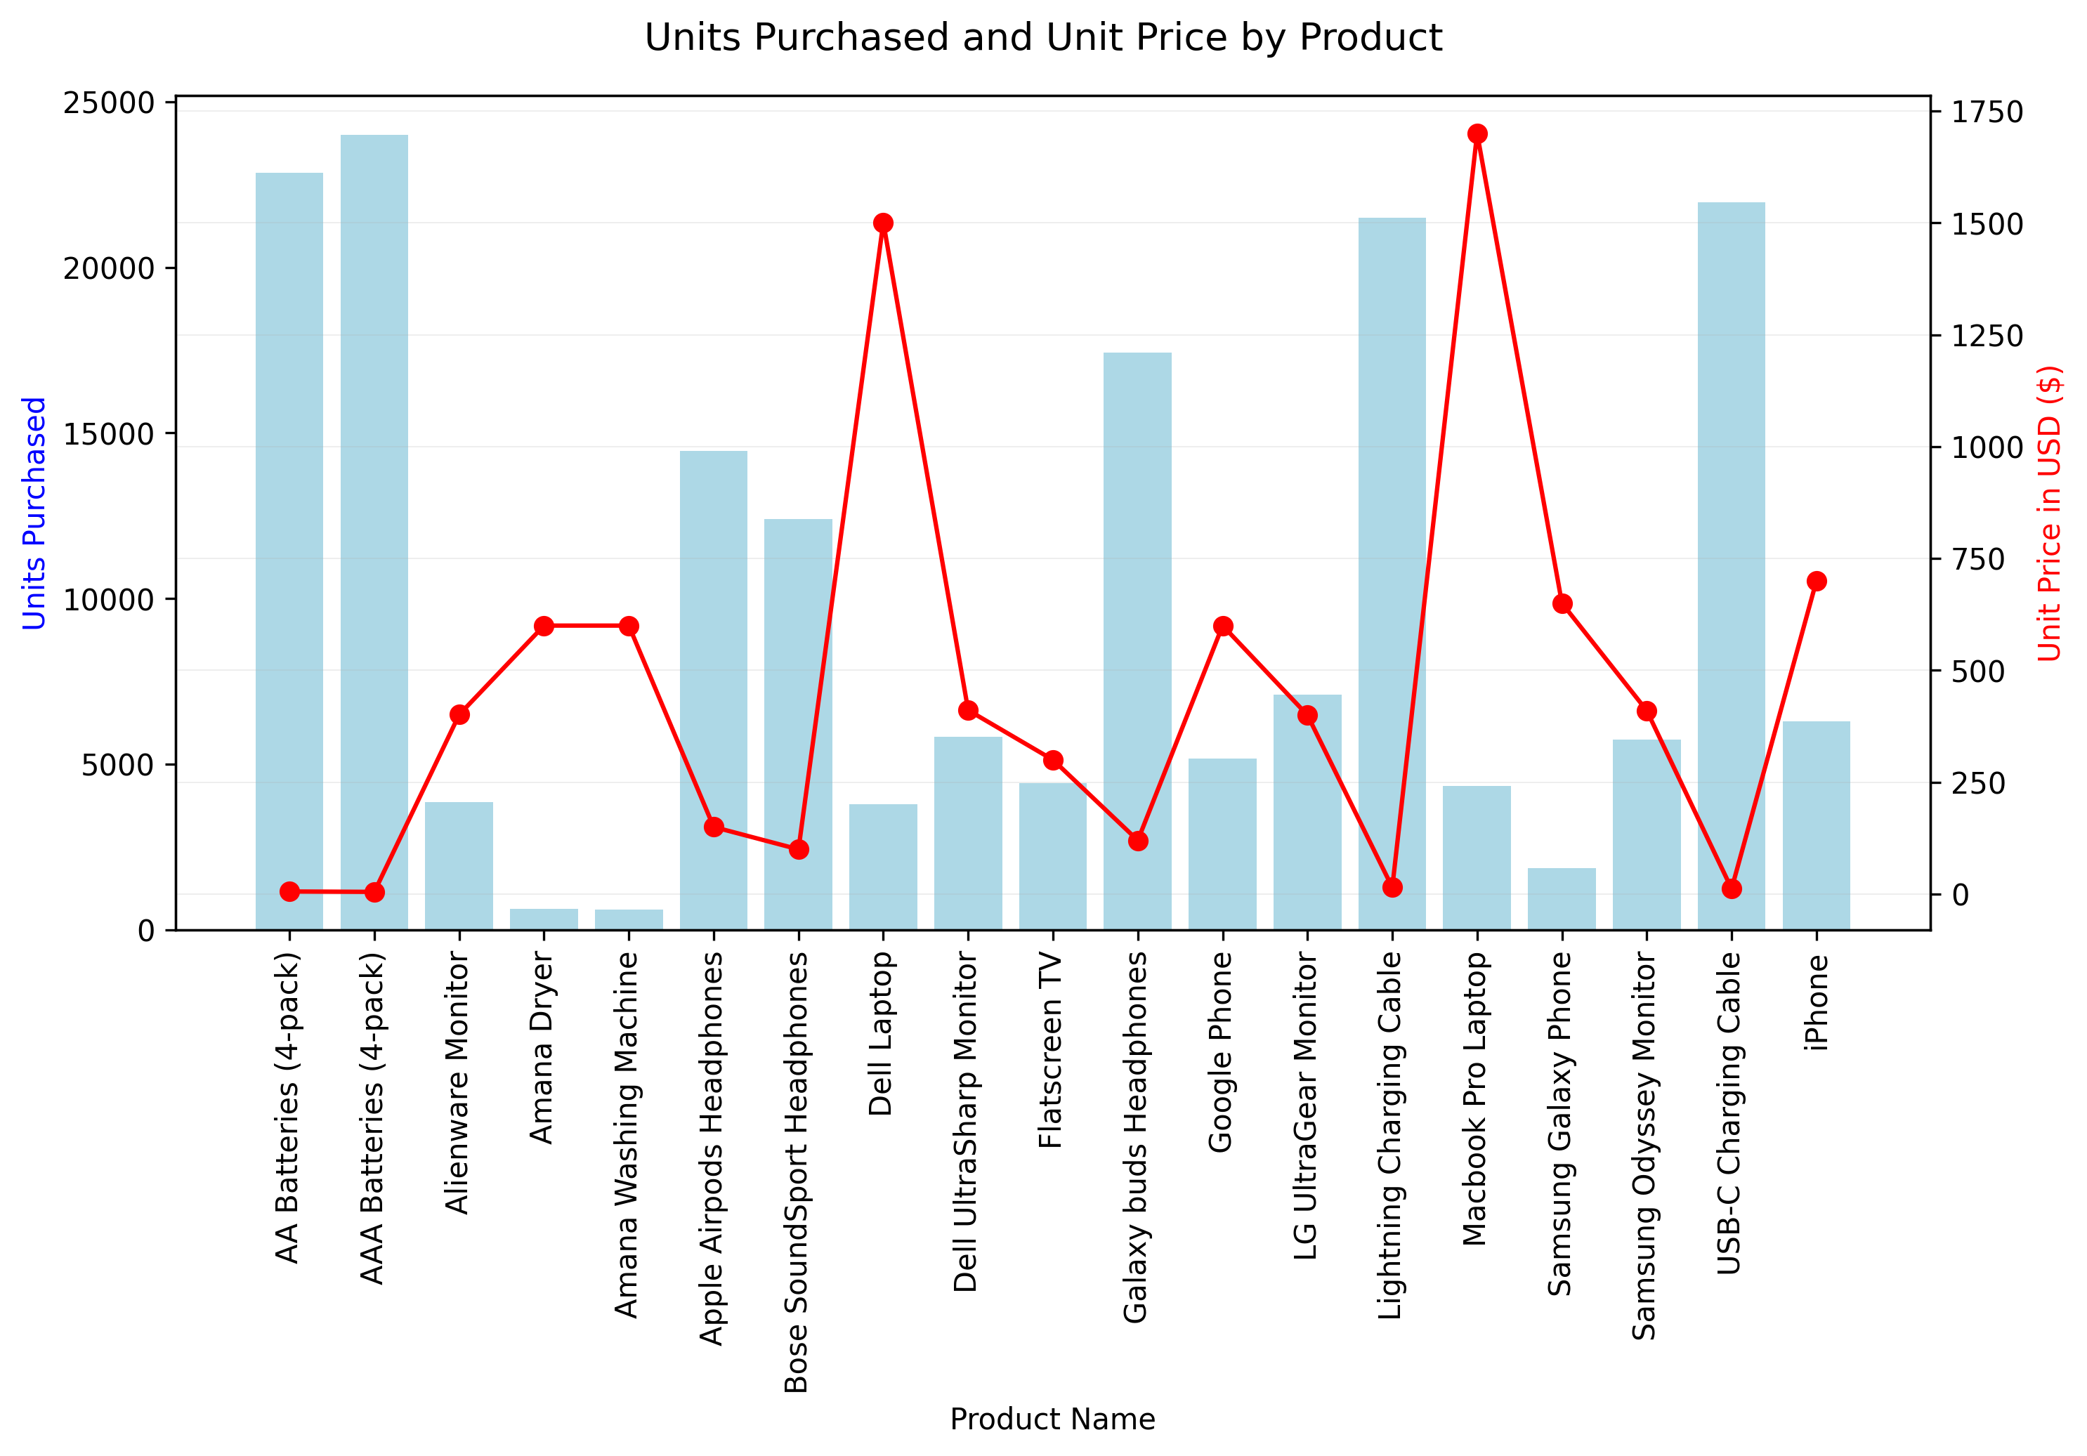
Which product had the highest sales, and what factors do you believe contributed to its success?
Product Sales Analysis: Spotlight on Performance
Key Insights
Accessories are the unsung heroes, AAA Batteries (23,993 units) outsell iPhones by 4x and MacBooks by 5.5x.
Galaxy Buds outshine AirPods and Bose, suggesting pricing and value perception trump brand loyalty.
High-value electronics underperform, likely due to price sensitivity and purchase frequency, needs repositioning or bundle support.
Olumide Balogun +234-8065060691
13

Slide 14
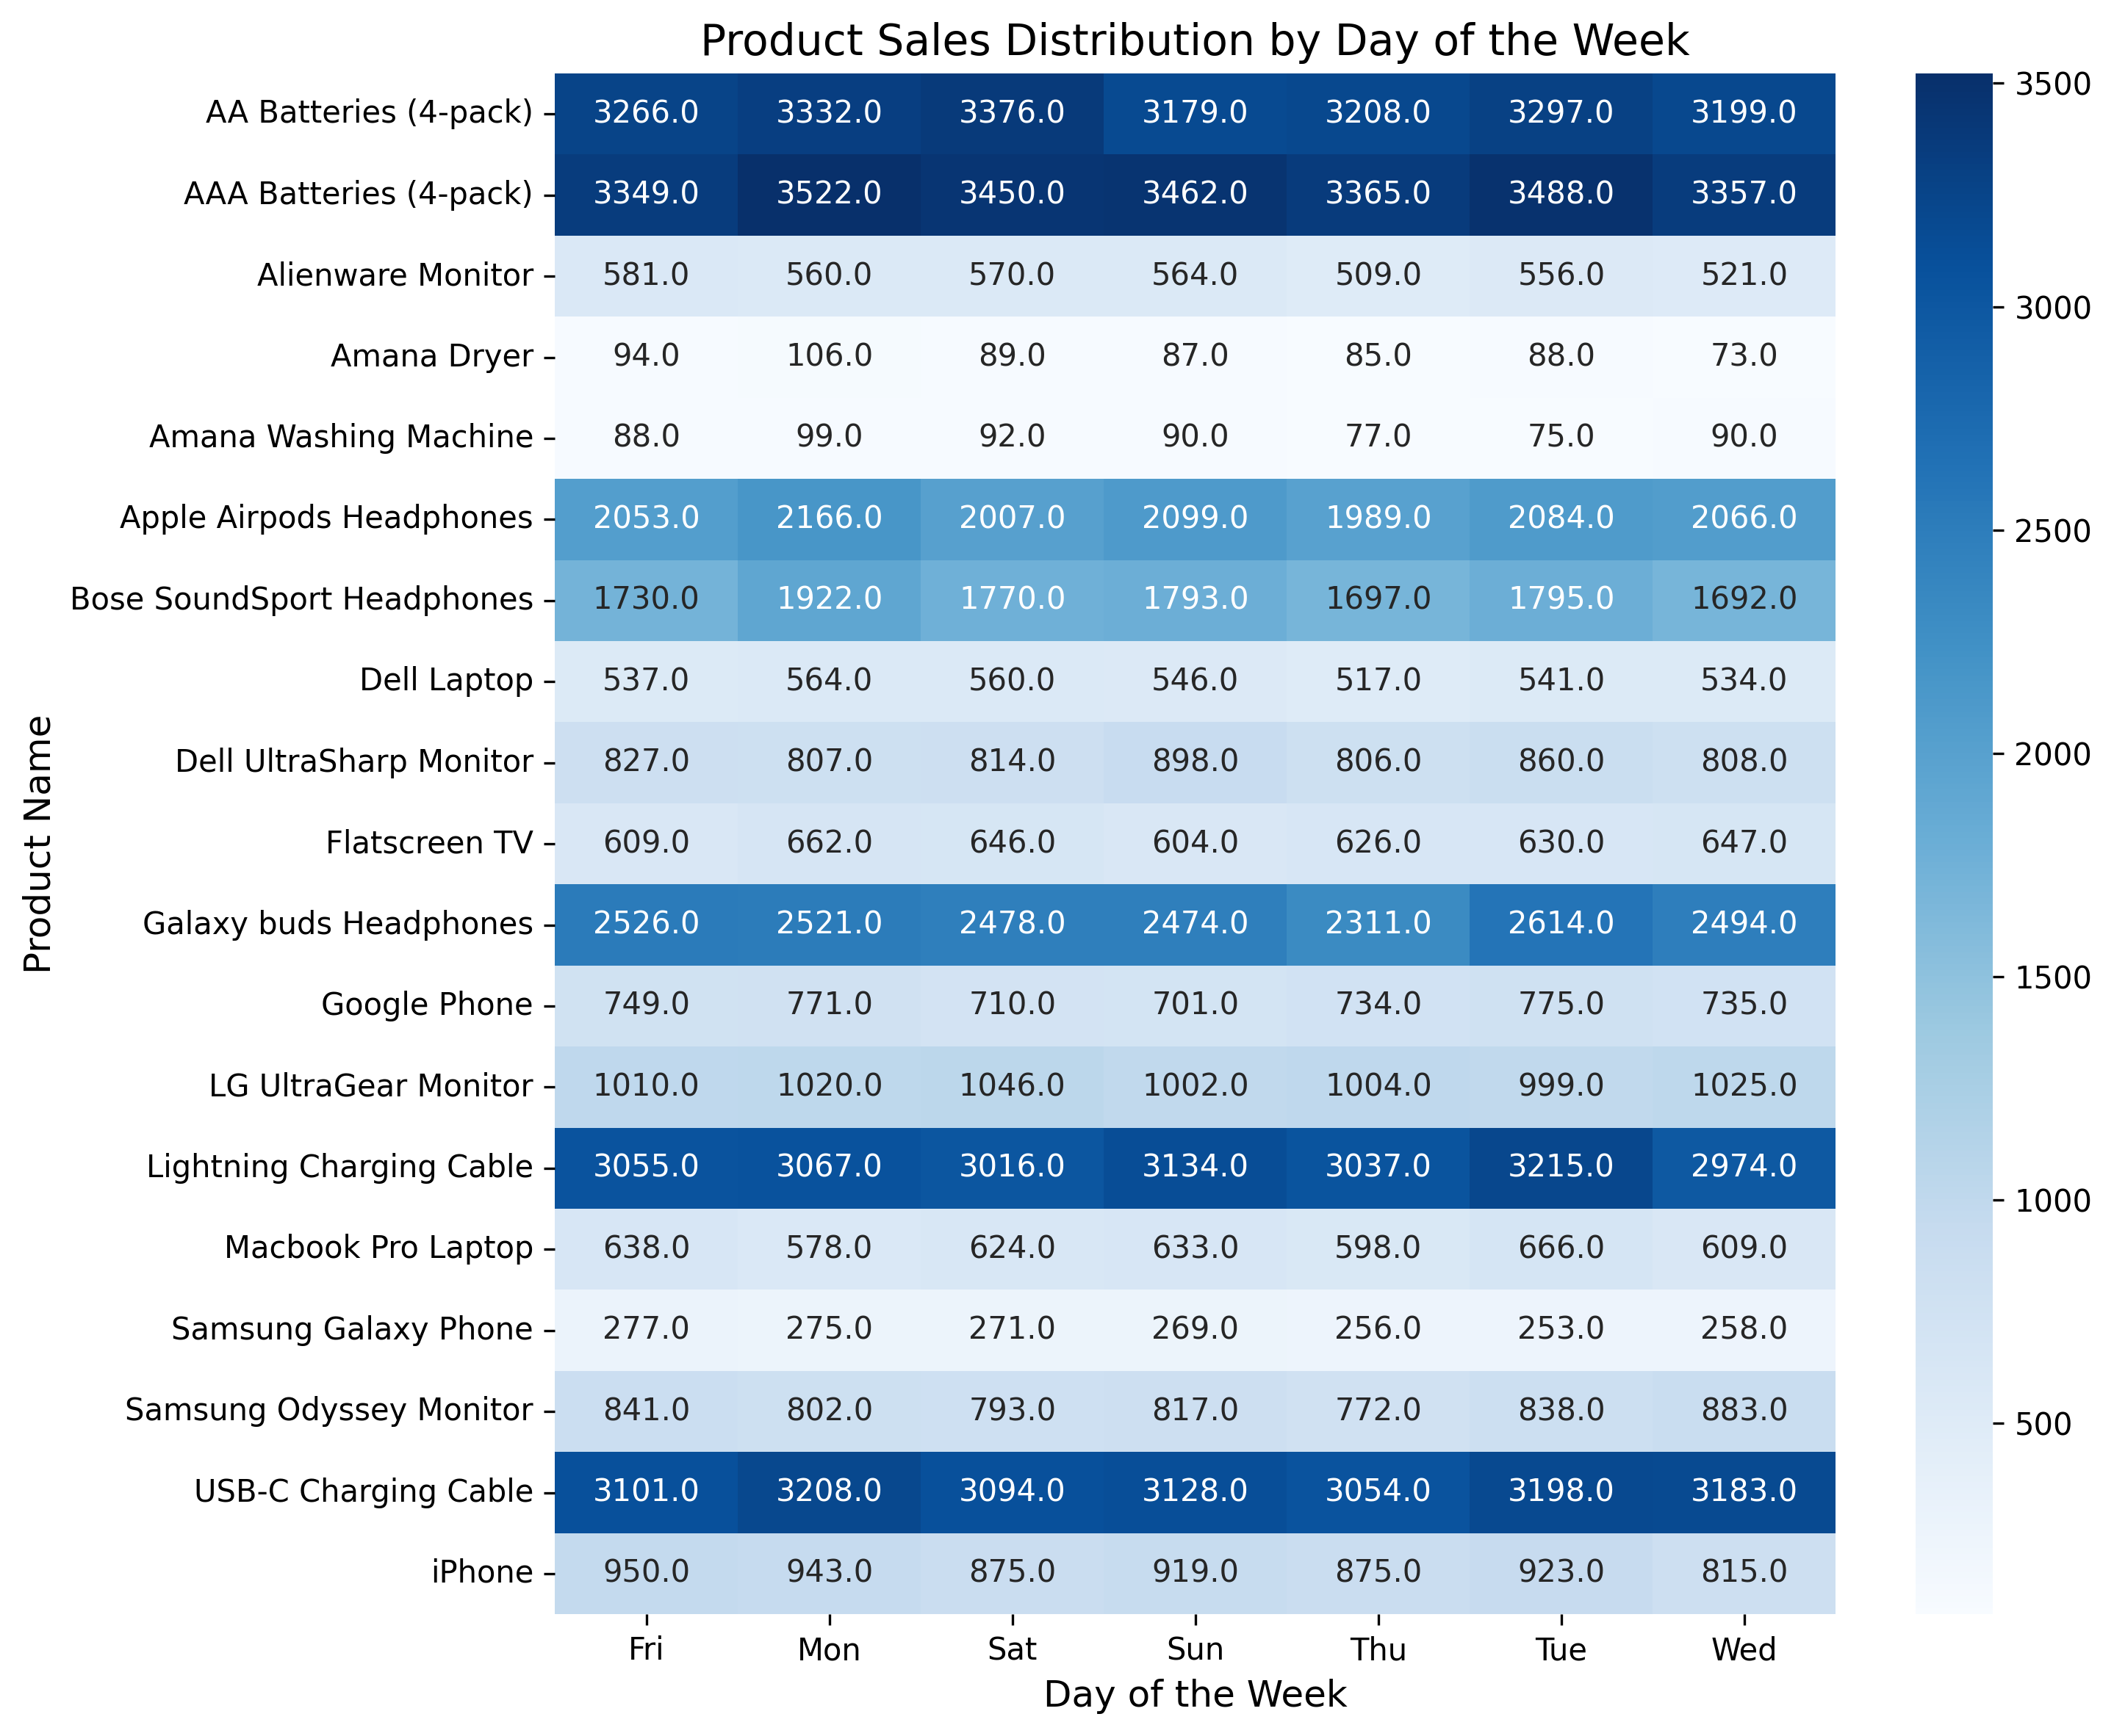
How do product sales vary across different days of the week, and what insights can be drawn from the distribution of order volumes by product and day?
Product Sales Performance Analysis
Key Insights
Top-selling items (batteries, cables, Galaxy Buds) maintain strong, consistent daily sales, ideal for automation and stock stability..
Entertainment products (TVs, headphones) spike over weekends, perfect for weekend campaign pushes.
Laptops peak early-week, especially Mondays, cater to “back-to-work” energy with productivity promos.
Olumide Balogun +234-8065060691
14

Slide 15
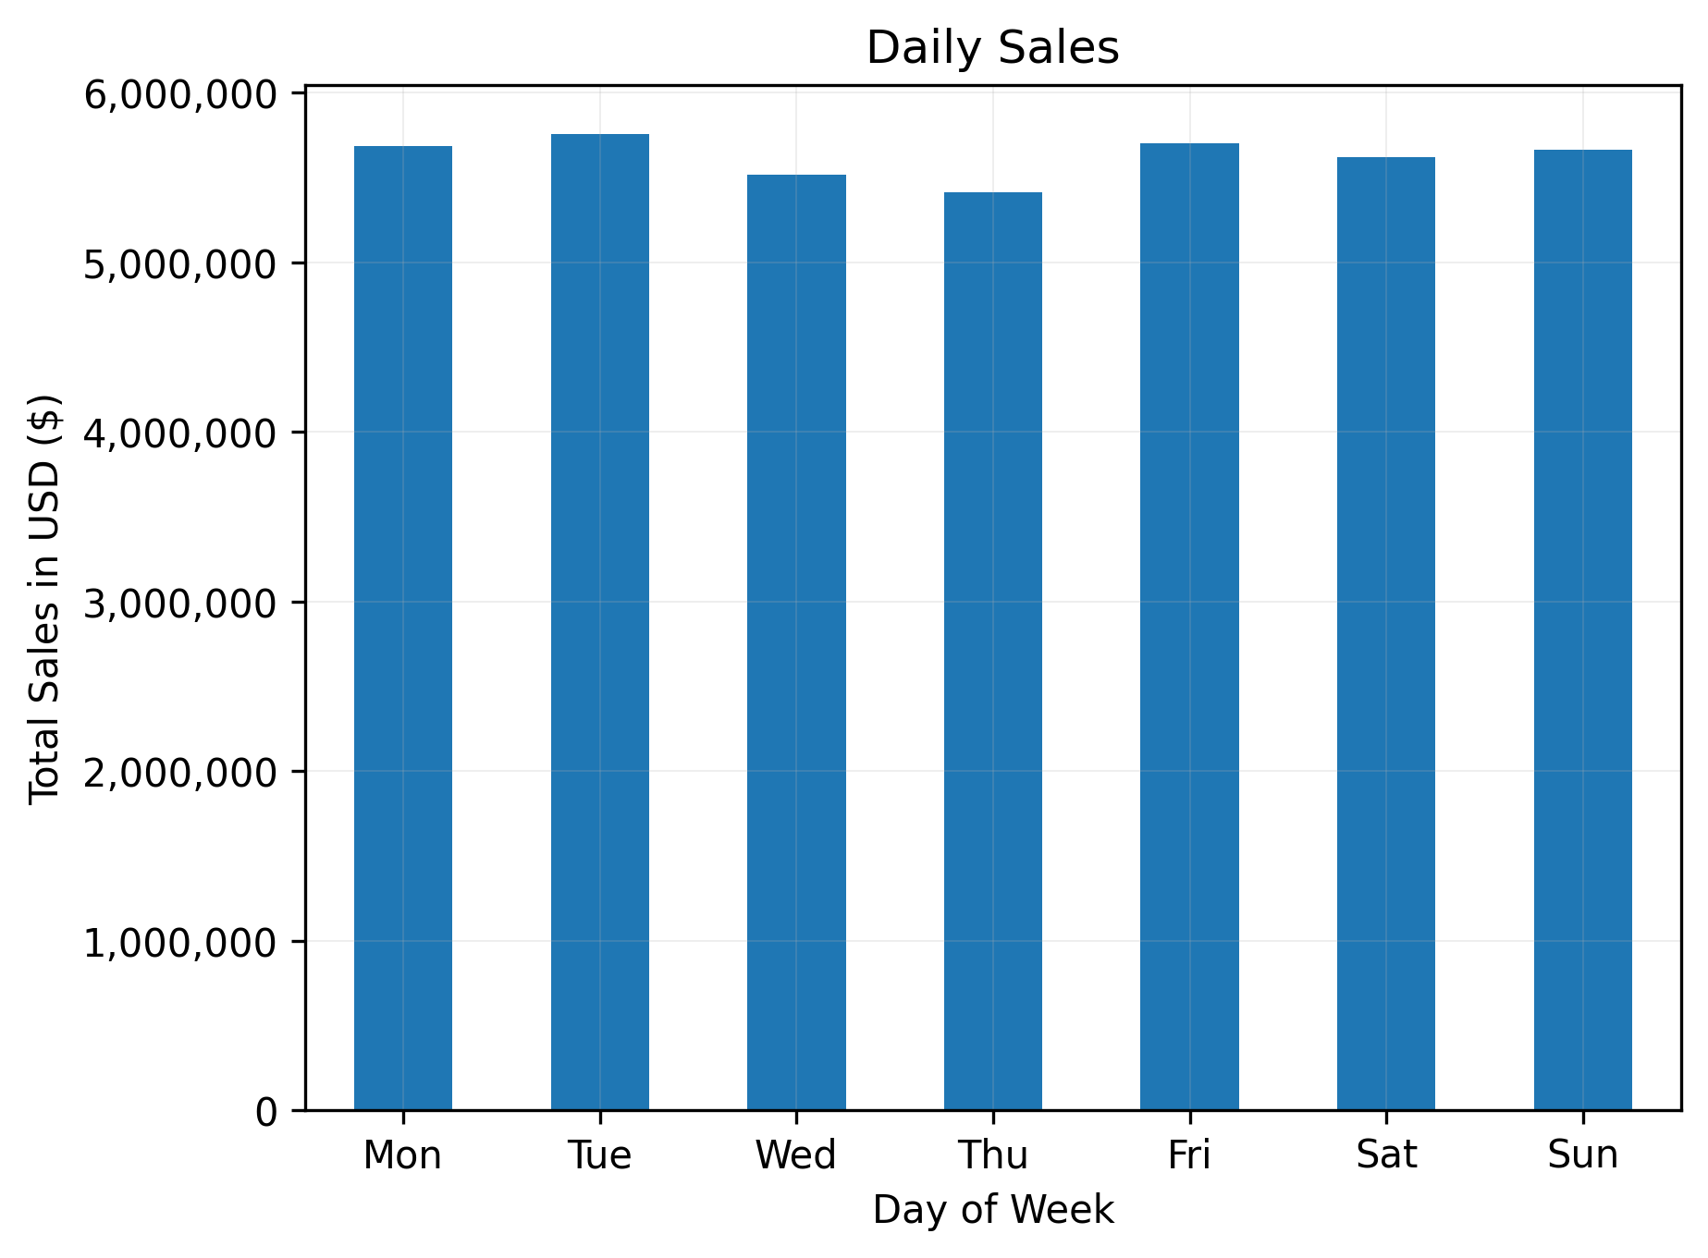
On which day of the week do customers make the most purchases?
Weekly Purchase Trends Analysis
Key Insights
Tuesday is king, with the highest total sales ($5.75M), the best day for major campaign launches.
Thursday is the quietest with total sales of $5.41M, revealing an opportunity for mid-week flash sales or loyalty nudges.
Sunday remains strong with total sales of $5.66M, which may reflect increased leisure-time shopping behavior aligning with leisure-time browsing and impulse purchases.
Olumide Balogun +234-8065060691
15

Slide 16
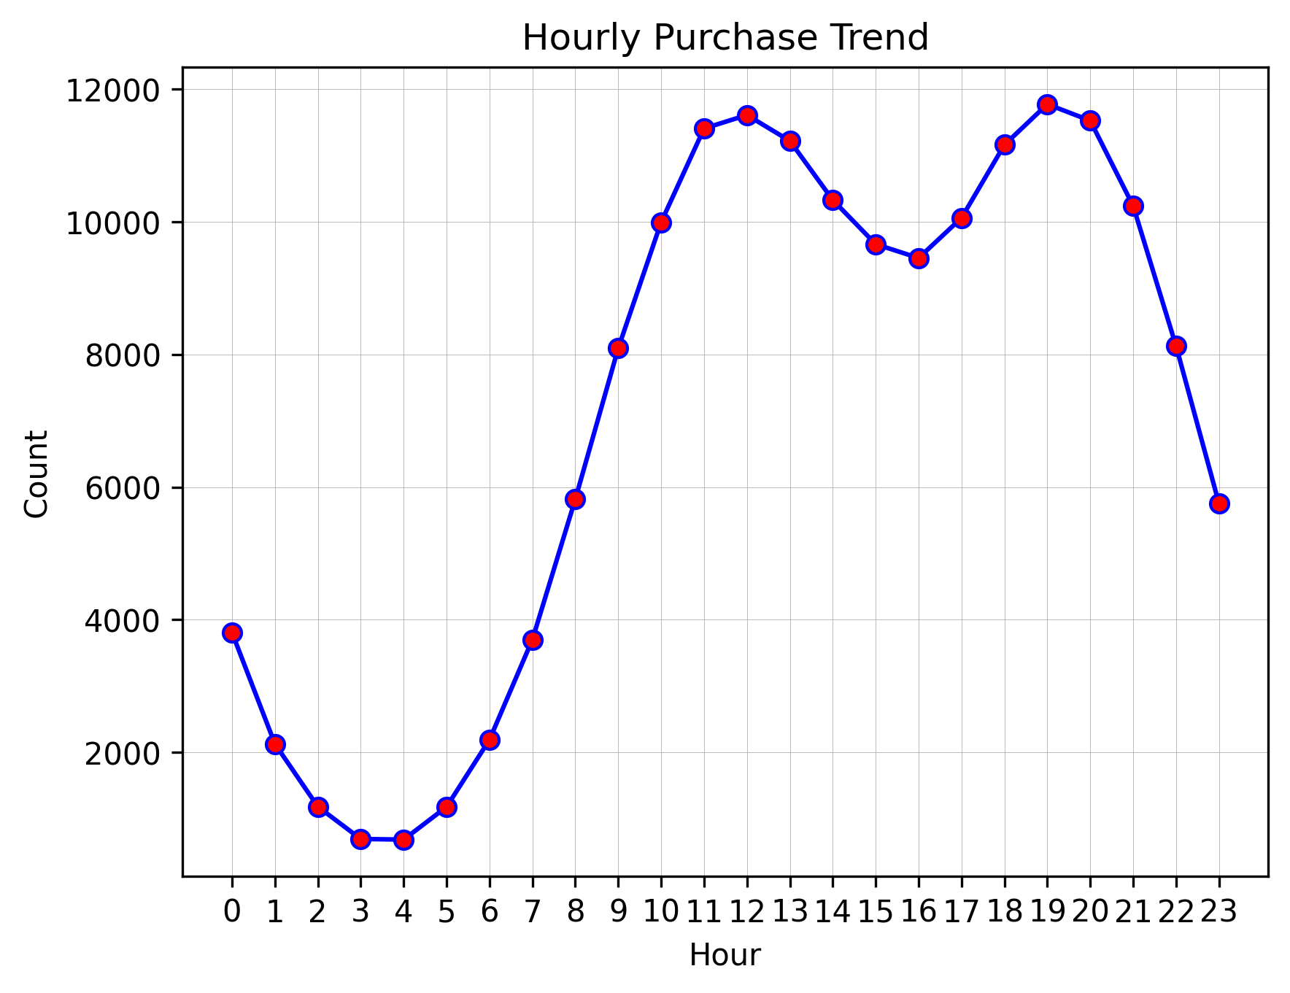
What is the optimal timing for advertisements and promotions to maximize customer purchases, based on historical purchase behavior?
Time Series Analysis: Uncovering Customer Purchase Patterns Over Time
Key Insights
Peak activity falls between 11 AM–1 PM and 6–8 PM, making these golden hours for ad spend and campaign drops.
Lowest engagement happens between 2 AM–5 AM, confirming minimal ROI for overnight marketing.
Purchasing behavior follows a daily rhythm, ideal for scheduling messaging that mirrors buyer energy levels.
Olumide Balogun +234-8065060691
16

Slide 17
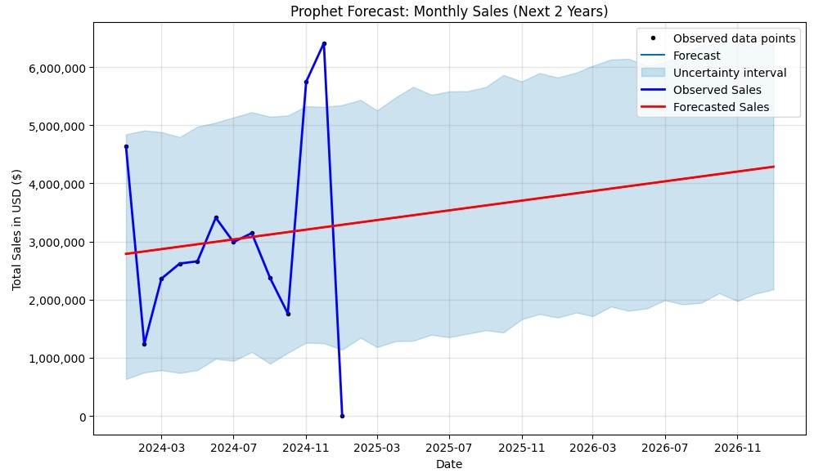
What will our monthly sales look like over the next two years based on historical purchasing patterns?
Sales Forecasting
Key Insights
Monthly sales show a healthy upward trajectory, with approximately $50K average growth, momentum is strong.
Q4 spikes expected, confirming need for early inventory and staff scaling.
Volatility projected in early 2025, confidence intervals widen in Feb–Apr, suggesting agility will be critical.
Olumide Balogun +234-8065060691
17

Slide 18
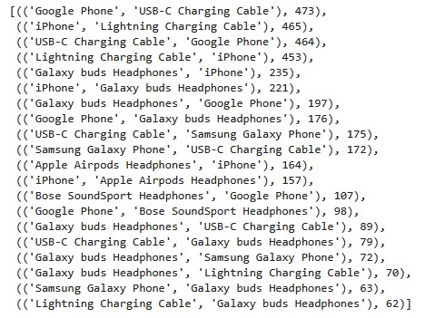
What products are frequently bought together?
Market Basket Analysis for Customer Purchase Insights
Key Insights
Accessory-first purchasing behavior (cables, chargers, earbuds) creates a goldmine for cross-sell strategies.
Strong Accessory Dependency:
Google Phone is frequently bought with the USB-C Charging Cable (473 times), and Samsung Galaxy Phone with the same cable (172 times), confirming a strong dependency on accessories.
A similar pattern was observed with the iPhone, frequently purchased alongside the Lightning Charging Cable (465 times) and Apple AirPods (157 times).
Olumide Balogun +234-8065060691
18

Slide 19
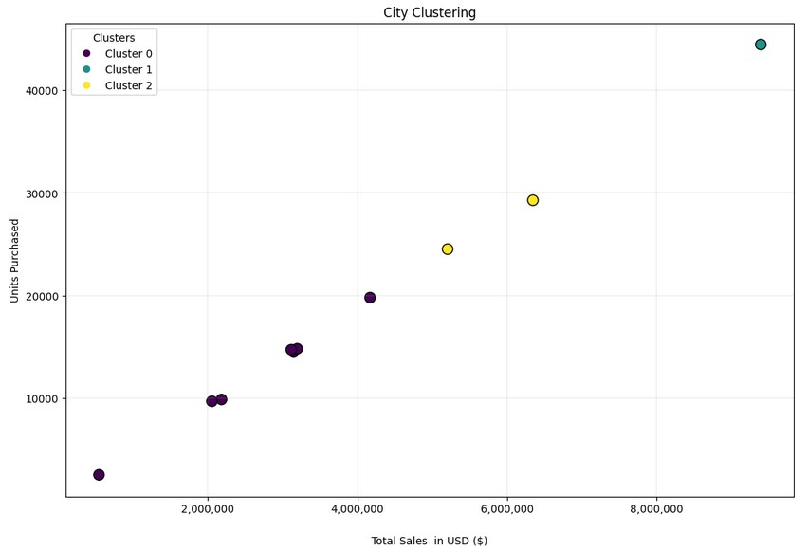
How can we group cities based on sales performance to uncover patterns for better sales strategy?
Clustering Cities by Sales Performance Using KMeans
Key Insights
San Francisco (CA), the only city in cluster 1, demonstrates strong performance in both revenue ($9.4M) and 44.42K unit sales.
Cluster 2 (Mid-tier): Stable, with room to grow, apply localized promotions and performance-based incentives.
Cluster 0 (Low-tier): Low sales, low volume, either rethink strategy or cut losses to improve ROI.
Olumide Balogun +234-8065060691
19

Slide 20

1. Double down on Q4 strategies: Scale marketing, inventory, and staffing to maximize November–December peak seasons.
2. Create targeted product bundles: Leverage high-frequency pairings (e.g., iPhone + Cable + AirPods) to boost Average Order Value (AOV).
3. Optimize campaign timing: Run high-impact promotions during peak activity windows (Tuesdays, 11 AM–2 PM, and 6–9 PM).
4. Expand in top-tier cities: Increase investment in high-performing cities like San Francisco, LA, and NYC.
5. Revive low-performing regions: Roll out localized campaigns in underperforming cities, and reassess long-term viability for continued investment.
6. Forecast-driven planning: Use Prophet-based sales forecasting to inform budgeting, procurement, and staffing plans.
7. Leverage clustering insights: Customize strategy by cluster to improve performance and resource allocation.
Strategic Recommendations
Olumide Balogun +234-8065060691
20

Slide 21

1. Growth & Profitability
Achieve 15–20% revenue uplift through strategic scaling during Q4 and bundling strategies.
Improve profit margins by 8–12% via product mix optimization and smarter inventory alignment.
Expected Business Impact
2. Operational Efficiency
Boost forecasting accuracy by 25–30% using Prophet modeling, enhancing demand planning and budgeting.
Reduce profit volatility by 10–15% through better timing of promotions and cost control.
3. Market Expansion & Sales Optimization
Increase regional market penetration by 10–14% through localized promotions in mid- and low-tier clusters.
Raise cross-/upsell revenue by 12–15% using market basket insights to personalize product recommendations and bundles.
Olumide Balogun +234-8065060691
21

Slide 22

Conclusion
This project demonstrates how the fusion of Exploratory Data Analysis and Machine Learning can transform raw sales data into clear, actionable strategies that fuel business growth.
By uncovering patterns across time, geography, products, and customer behavior, the project effectively answers key business questions, identifying top-performing months, cities, and products, while spotlighting hidden opportunities in product bundling, promotion timing, and customer segmentation.
But this project goes beyond just visualizing what happened, it strategically connects insights to execution, using Python-powered analytics, predictive modeling, and real business acumen. It equips stakeholders with intelligent, scalable recommendations that optimize marketing, streamline inventory, and future-proof decision-making.
Olumide Balogun +234-8065060691
22

Slide 23
BALOGUN OLUMIDE CHRIS CONTACTS
Tel: +234(0)8065060691
Email: krisbalo11@gmail.com
Github - https://github.com/olumidebalogun1
LinkedIn -https://www.linkedin.com/in/olumide-balogun1/
Medium - https://medium.com/@Olumide-Balogun
X - https://x.com/IAmOluBalogun
Olumide Balogun +234-8065060691

